Slide 1
Unit 5 :
Making inquiries
Session 2
Databases

Slide 2
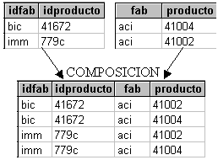
Cartesian product
The Cartesian product of two tables allows us to obtain a table with the columns of the first table and the columns of the second table (even if they have the same names).
The rows of the resulting results sheet are all possible combinations between rows from the first table and rows from the second table. Thus, if one table has 6 rows and the other has 8, the result of the Cartesian product is a table of 48 rows. But if a table has 6,000 rows and another 8,000, a table of 48 million rows is created in memory, each containing several bytes. This means creating a lot of memory space and can be a SERIOUS PROBLEM.

Slide 3
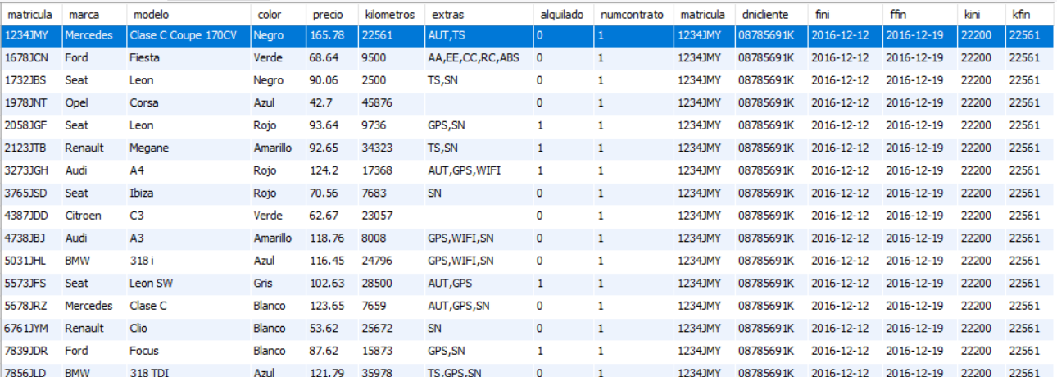
Cartesian product
To obtain the total Cartesian product between two tables, write * (all columns) after SELECT and the names of the two tables separated with a comma after FROM. It is not very normal to have to obtain the total Cartesian product between two or more tables. The normal thing is that we apply conditions to the result of a Cartesian product to extract the combined data we want.
For example, if we execute:
SELECT * FROM cars,contracts;

Slide 4
Cartesian product
We see that in the result we see multiple rows for contract 1. We see that this contract corresponds to the registration number 12434JMY. But that contract has been combined with each of the cars, that is, it has been combined with cars with license plates other than those on the contract. The logical thing is that, for each contract, we relate the contract with the data of the corresponding car. This must be done with a WHERE condition.
SELECT * FROM automobiles,contracts WHERE automobiles.registration = contracts.registration;
Although we now see a row for each contract in the result, an intermediate table with the complete Cartesian product has actually been created in memory.

Slide 5

Cartesian product
We are going to see several examples in which queries are made in which the Cartesian product can be used. The Cartesian product combination is applied and WHERE selection conditions are established and the columns or expressions that you want to consult are indicated.
Example: Obtain the license plate, make, model, start date and end date of contract number 1 (the WHERE condition will have to be established for the contract to be number 1 and for the car's license plate to match that of the contract).
SELECTcontratos.matricula ,brand,model,fini, ffin FROM automobiles,contratos WHERE numcontrato=1 ANDtrabajos.matricula =automoviles.matricula;
We see that the statement must use table qualifiers on columns that have the same name in both tables.

Slide 6
Cartesian product
When combining tables it can sometimes be useful to rename them. For example, the instruction used on the previous slide:
SELECT contactors.matricula,brand,model,fini,ffin FROM automobiles,contratos WHERE numcontrato=1 ANDtrabajos.matricula=automoviles.matricula;
It would be equivalent to this one that uses table renaming:
SELECT c.registration,make,model,fini,ffin FROM automobiles AS a , contracts AS c WHERE contractnum=1 AND c.registration=a.registration;

Slide 7
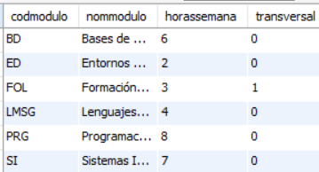
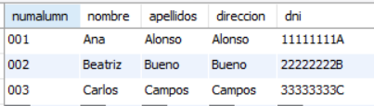
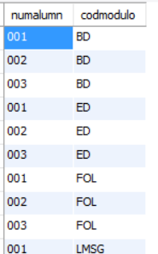
Cartesian product
Example: Assuming that we have in a database a table with the modules of a course and another table with the students of the course, perform a query that obtains all the possible combinations of codes or numbers of students with all the module codes of the course DAM1.
SELECT numalumn,modulecode FROM pupils,modules ORDER BY modulecode;

Slide 8
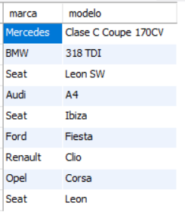
Cartesian product
Example: In the rental database, obtain the make and model (without repeating) of all the cars ever hired in December 2017.
SELECT DISTINCT make, model FROM automobiles, contracts WHERE automobiles.matricula=contratos.matricula AND fini LIKE '2017-12%';

Slide 9
Cartesian product
Example: From car rental contract number 10, obtain the client who made the contract, the license plate, make and model of the car and the duration of the contract.
SELECT last name, first name, contracts.matricula, make, model, fini, ffin FROM automobiles, contracts, clients WHERE automobiles.matricula = contracts.matricula AND contracts.dnicliente=clientes.dni AND contractnum=10;

Slide 10
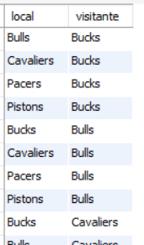
Cartesian product
Example: In an NBA database we have a teams table. In the teams table, among other data, you have the name of the team and the division in which it participates. Obtain all possible confrontations or matches between teams in the central division. The teams table will have to be combined with itself, preventing the home and visitor teams from being the same.
SELECT a.local AS name,b.visitor AS name FROM AS teams a, AS teams b WHERE a.division='central' AND b.division='central' AND a.name <> b.name;

Slide 11
Cartesian product
IMPORTANT:
The Cartesian product should be avoided, as long as the query can be performed with another join operation, when the tables being joined have many rows.
The join produces the product of the number of rows combined and that can be many, many rows (and many columns too). All of that is temporarily stored in RAM and takes up a lot of space.
The queries in the examples on slides 7 and 1 0 are cases of good use of the Cartesian product since there we do want to combine all the rows of one table with all the rows of the other.
However, the other examples in this section could be performed more optimally with other join operations.

